Slide 1
CSE 474 Quality Assurance
Week 12 Extrinsic Risks

Slide 2
5. QA Processes
(V&V, Reviews, Audits)
8. Reviews & Audits
(Tech, Mngt., Inspection, walk-throughs, checklist)
10. Configuration Management
1. Fundamentals & Business Case for Quality Assurance
(IEEE SWBok)
9. Maturity
(CMM, Process, Product, ISO)
11. Risk/Mission Assurance
(Training, CAR, Mitigation)
6. QA Tools
(Fishbone, check, Histograms, Pareto, Scatter, Stratification)]
12. Security/ Legal/ Ethics
(Regulations, Code, Legal, Safety)
2. QA’s Role in SW Lifecycle, Methodologies,
Architecture
[Responsibilities & Roles]
7. QA Attributes
(Verification and Validation )
13 . Project Management
(CoQ, WBS, DevOps )
[VDD, Version, DM, DI]
14. Careers Path
3. QA Techniques
(Dyn, Static, and Testing)
[]
4. Quality Metrics
(Characteristic & Models)
[Measuring]
Know
Do
Become
SWE 474: Quality Assurance Class

Slide 3
Overview
Reading
Assignments
W12: Security: How can QA help reduce security risks?
W12: Prove: Complete SQAP Section 13: Training

Slide 4
Reading
L. Westfall Certified Software Quality Engineer Handbook, ASQ Quality Press, 2009-09-01, https://ebookcentral.proquest.com/lib/byui/detail.action?docID=3002591
Chapter 2: B. Ethical and Legal Compliance
Chapter 3: C. Standard and Models
http://targetedattacks.trendmicro.com/
http://datacenterattacks.trendmicro.com/
M. Paulk et al., "Capability Mature Model for Software, Version 1.1," Chapter 1-3 IEEE Software, vol. 10, no. 4, pp. 18-27, Jul. 1993. [Online] Available: http://dx.doi.org.byui.idm.oclc.org/10.1109/52.219617
Read sections
Training Program p 212
"IEEE Standard for System, Software, and Hardware Verification and Validation," in IEEE Std 1012-2016 (Revision of IEEE Std 1012-2012/ Incorporates IEEE Std 1012-2016/Cor1-2017) , vol., no., pp.1-260, 29 Sept. 2017, doi: 10.1109/IEEESTD.2017.8055462.
https://ieeexplore-ieee-org.byui.idm.oclc.org/document/8055462
Please read over this lightly and become familiar with its format and structure.
Section 9: Software V&V processes – only elements dealing with Hazard, security, and risk analysis.
Annex J Hazard, security, and risk analysis

Slide 5
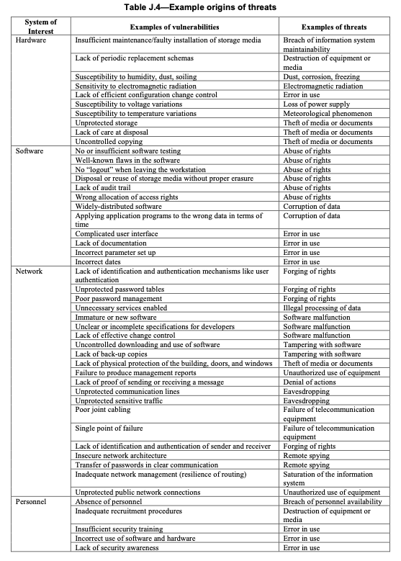
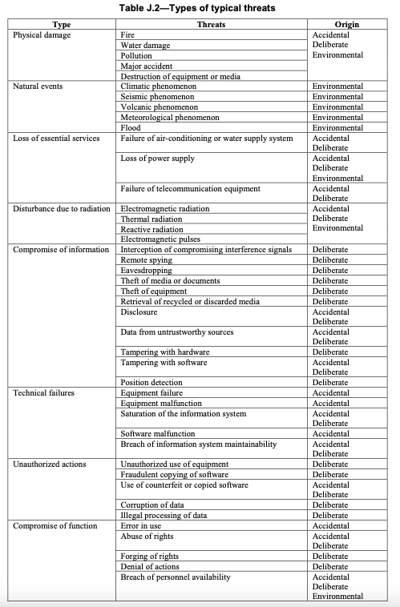
How can QA help reduce security risks?
Step 1: Identify a security threat
Pick a scenario from the book reading (Chap2: Contract, IP, Tort, Data Privacy).
Then from Table J.4, pick what part of the System might the threat (Hardware, Software, Network, Personal, Site, or Organization) occur.
Once picked, then from the same row, pick an Example of vulnerabilities.
Take note of the Example of threat, use that to look up in Table J.2 Types of typical threats, and find the Type and Origin of the threat. If there is more than one origin, then pick one.
Complete the following information:
(J.4) System of Interest:
(J.4) Example of Vulnerability:
(J.4) Example of Threat/(J.2)Threat
(J.2) Type:
(J.2) Origin:

Slide 6
How can QA help reduce security risks?
Step 2: Create a training checklist
Sometimes, it is better to create the test before you make the code in programming. You need to create a checklist of items that are required in training.
Using the reading, create a checklist to review training. This checklist should contain 5+ items that should be included in the training. Provide two examples of training that might be needed from your scenario.
Step 3: Complete a Risk Analysis, Causal Analysis, or both.
Using the information you learned from last week, complete risk analysis on your scenario. Identify the risk. Provide the criteria, the scale, and the stoplight. Identify which mitigation method should be used. And determine how it will cost the company.

Slide 7
How can QA help reduce security risks?
Step 4: Create training.
Create training that could prevent your scenario from happening. It should address the issue, the risk factors, and the mitigation to prevent it from happening. The training should provide triggers that would cause it to happen and whom to contact.
The training can be in any form, for example, 5-6 slide ppt, a memo, a poster, a flyer, or a class lecture.
Step 5: Review another team’s training.
Connect with another team, and have them review your training. Connect with another team, and review their training. As a team, address each of the findings.
Update your training as Version 2.0. Identify the root cause of what caused you to miss those findings.

Slide 8
Complete SQAP Section 4, 5, 13: Training
Part 1: Section 4: Documentation
You will use the IEEE V&V tasks, input, output tables to identify documentation. Also, use the SWEBoK, PMBoK, CMM, and any other reading. Make sure you list plans according to the categories found in IEEE 730-2020. Add two documents to each of the Tables 4.1 through Table 4.4.

Slide 9
Complete SQAP Section 4, 5, 13: Training
Part II: Section 5: Standards, Practices, conventions, and metrics.
The information contains references standards, policies, conventions, and metrics. There are two sections, Purpose and Content. The first section includes the purpose with an overview of standards, practices, conventions, techniques, quality requirements, and metrics. It also addresses conformance to this overview information. The second section addresses standards that the project is following. You will need to cross-reference CMM and IEEE V&V.
Section 5: Standards, Practices, conventions, and metrics
5.1 Purpose
Overview – brief description of this section
Standards – reference the standards we are using in this class.
Practices – Use practices from the IEEE V&V document.
Conventions -
Statistical Techniques – list the items from Module 6: Tools
Quality Requirements – gather these requirements from IEEE V&V and Week 04 reading.
Metrics – use the metrics you established from Module 04 and IEEE V&V and reading.
Conformance
Using Module 10 Configuration Management, identify how these items will be monitored and assured. Identify how often the project will check for organizational changes and when they will be used to review and audit the project.
5.2 Content – describe this section in the frame of the project.
Documentation standards – reference documentation standards found from the reading.
Design standards – Use the information found in IEEE V&V
Coding and Commentary standards – The project will use derived versions of Google’s programming language styles for higher-level languages. Use this as a reference.
Testing standards and practices
Use Module 7 as a reference to fill in this section.
Selected software quality assurance product and process metrics
Week 04 Model and Characteristics
CMM: 2 SQA, 4 QPM SQM

Slide 10
Complete SQAP Section 4, 5, 13: Training
Part III: Section 13 Training
The project will provide training for quality assurance in developing software. Training will follow a checklist. The section will contain two parts.
Part 1: First, list essential roles responsibilities based on Section 3. The first part will identify items training needs for each of the roles.
Step 1: Examine CMM Level 3: Training Program abilities 1,3 Determine what is needed: What should be in the plan vs. what should be in training. Summary of your finding into an outline for this section.
Step 2: Search the CMM reading for training. Find all activities that require training, either specifically or by example. Make a list of your findings. Organize the list based on your predetermined categories. Include this in the SQAP with a summary of each of your categories.
Step 3: Using previous readings, identify a list of roles used during the software lifecycle. Make sure you cross-reference them with the reading. Identify which roles need to take each of the training categories or items in the list. Identify which items in your training list are associated with each software lifecycle phase.
Part 2: The second part contains a generalized checklist of elements developed and revised in the previous assignment. Make sure that you identify training requirements found in CMM.

Slide 11
Reading
L. Westfall Certified Software Quality Engineer Handbook, ASQ Quality Press, 2009-09-01, https://ebookcentral.proquest.com/lib/byui/detail.action?docID=3002591
Chapter 2: B. Ethical and Legal Compliance
Chapter 3: C. Standard and Models
http://targetedattacks.trendmicro.com/
http://datacenterattacks.trendmicro.com/
M. Paulk et al., "Capability Mature Model for Software, Version 1.1," Chapter 1-3 IEEE Software, vol. 10, no. 4, pp. 18-27, Jul. 1993. [Online] Available: http://dx.doi.org.byui.idm.oclc.org/10.1109/52.219617
Read sections
Training Program p 212
"IEEE Standard for System, Software, and Hardware Verification and Validation," in IEEE Std 1012-2016 (Revision of IEEE Std 1012-2012/ Incorporates IEEE Std 1012-2016/Cor1-2017) , vol., no., pp.1-260, 29 Sept. 2017, doi: 10.1109/IEEESTD.2017.8055462.
https://ieeexplore-ieee-org.byui.idm.oclc.org/document/8055462
Please read over this lightly and become familiar with its format and structure.
Section 9: Software V&V processes – only elements dealing with Hazard, security, and risk analysis.
Annex J Hazard, security, and risk analysis

Slide 12
Chapter 2 B. Ethical and Legal Compliance
1. ASQ Code of Ethics
Conflicts of Interest
2. Legal and Regulatory Issues
Contracts
Intellectual Property Rights
Data Privacy
Sarbanes-Oxley Act
Tort
Black’s Law Dictionary (Futrell 2002) defines a tort as “a wrongful act other than a breach of contract that injures another and for which the law imposes civil liabilities.”
Conversion - steal from the customer or destroy property
Negligence - failure to complete step that could cause damage
Strict product liability - dangerous defects
Malpractice - poor professional services
Fraud - misrepresented capabilities

Slide 13

ACM Code of Ethics and Professional Conduct
1. GENERAL ETHICAL PRINCIPLES.
1.1 Contribute to society and to human well-being, acknowledging that all people are stakeholders in computing.
1.2 Avoid harm.
1.3 Be honest and trustworthy.
1.4 Be fair and take action not to discriminate.
1.5 Respect the work required to produce new ideas, inventions, creative works, and computing artifacts.
1.6 Respect privacy.
1.7 Honor confidentiality.
2. PROFESSIONAL RESPONSIBILITIES.
2.1 Strive to achieve high quality in both the processes and products of professional work.
2.2 Maintain high standards of professional competence, conduct, and ethical practice.
2.3 Know and respect existing rules pertaining to professional work.
2.4 Accept and provide appropriate professional review.
2.5 Give comprehensive and thorough evaluations of computer systems and their impacts, including analysis of possible risks.
2.6 Perform work only in areas of competence.
2.7 Foster public awareness and understanding of computing, related technologies, and their consequences.
2.8 Access computing and communication resources only when authorized or when compelled by the public good.
2.9 Design and implement systems that are robustly and usably secure.

Slide 14

ACM Code of Ethics and Professional Conduct
3. PROFESSIONAL LEADERSHIP PRINCIPLES.
3.1 Ensure that the public good is the central concern during all professional computing work.
3.2 Articulate, encourage acceptance of, and evaluate fulfillment of social responsibilities by members of the organization or group.
3.3 Manage personnel and resources to enhance the quality of working life.
3.4 Articulate, apply, and support policies and processes that reflect the principles of the Code.
3.5 Create opportunities for members of the organization or group to grow as professionals.
3.6 Use care when modifying or retiring systems.
3.7 Recognize and take special care of systems that become integrated into the infrastructure of society.
4. COMPLIANCE WITH THE CODE.
4.1 Uphold, promote, and respect the principles of the Code.
4.2 Treat violations of the Code as inconsistent with membership in the ACM.

Slide 15
ASQ Code of Ethics
Fundamental Principles
ASQ requires its members and certification holders to conduct themselves ethically by:
I. Being honest and impartial in serving the public, their employers, customers, and clients
II. Striving to increase the competence and prestige of the quality profession, and
III. Using their knowledge and skill for the enhancement of human welfare
Members and certification holders are required to observe the tenets set forth below:
Relations with the Public
Article 1—Hold paramount the safety, health, and welfare of the public in the performance of their professional duties.
Relations with Employers and Clients
Article 2—Perform services only in their areas of competence.
Article 3—Continue their professional development throughout their careers and provide opportunities for the professional and ethical development of others.
Article 4—Act in a professional manner in dealings with ASQ staff and each employer, customer, or client.
Article 5—Act as faithful agents or trustees and avoid conflict of interest and the appearance of conflicts of interest.
Relations with Peers
Article 6—Build their professional reputation on the merit of their services and not compete unfairly with others.
Article 7—Assure that credit for the work of others is given to those to whom it is due.

Slide 16
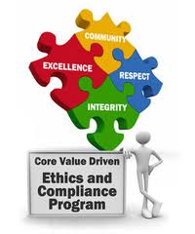
7.8 IEEE Code of Ethics
I. To uphold the highest standards of integrity, responsible behavior, and ethical conduct in professional activities.
1. to hold paramount the safety, health, and welfare of the public, to strive to comply with ethical design and sustainable development practices, to protect the privacy of others, and to disclose promptly factors that might endanger the public or the environment;
2. to improve the understanding by individuals and society of the capabilities and societal implications of conventional and emerging technologies, including intelligent systems;
3. to avoid real or perceived conflicts of interest whenever possible, and to disclose them to affected parties when they do exist;
4. to avoid unlawful conduct in professional activities, and to reject bribery in all its forms;
5. to seek, accept, and offer honest criticism of technical work, to acknowledge and correct errors, to be honest and realistic in stating claims or estimates based on available data, and to credit properly the contributions of others;
6. to maintain and improve our technical competence and to undertake technological tasks for others only if qualified by training or experience, or after full disclosure of pertinent limitations;
II. To treat all persons fairly and with respect, to not engage in harassment or discrimination, and to avoid injuring others.
7. to treat all persons fairly and with respect, and to not engage in discrimination based on characteristics such as race, religion, gender, disability, age, national origin, sexual orientation, gender identity, or gender expression;
8. to not engage in harassment of any kind, including sexual harassment or bullying behavior;
9. to avoid injuring others, their property, reputation, or employment by false or malicious actions, rumors or any other verbal or physical abuses;
III. To strive to ensure this code is upheld by colleagues and co-workers.
10. to support colleagues and co-workers in following this code of ethics, to strive to ensure the code is upheld, and to not retaliate against individuals reporting a violation.

Slide 17
Ethics
ISC2 requires all certified system security professionals to commit to fully supporting its Code of Ethics
https://www.isc2.org/ethics/default.aspx
Act honorably, honestly, justly, responsibly, legally, and protect society
Work diligently, provide competent services, and advance the security profession
Encourage the growth of research – teach, mentor, and value the certification
Discourage unnecessary fear or doubt, and do not consent to bad practices
Discourage unsafe practices, and preserve and strengthen the integrity of public infrastructures
Observe and abide by all contracts, expressed or implied, and give prudent advice
Avoid any conflict of interest, respect the trust
That others put in your, and take on only those jobs
you are fully qualified to perform
Stay current on skills, and do not involved with activities that could injure the reputation of
other security professionals

Slide 18
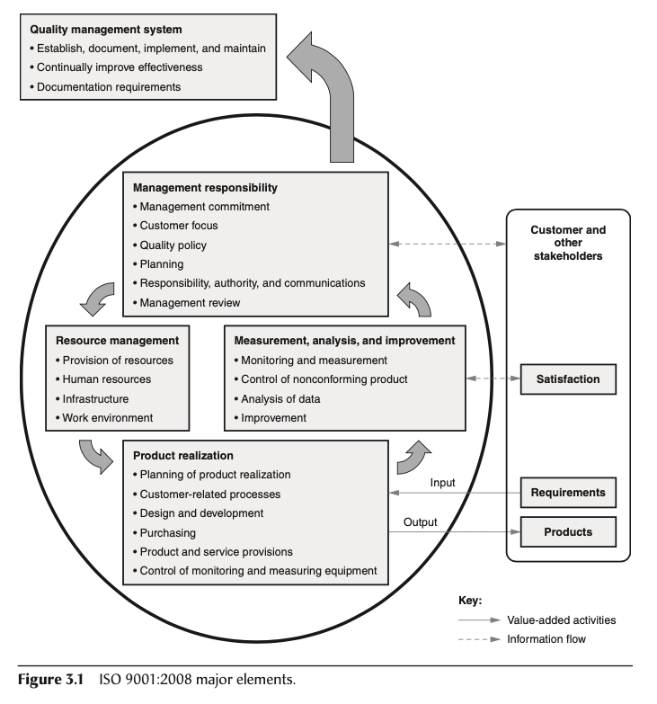
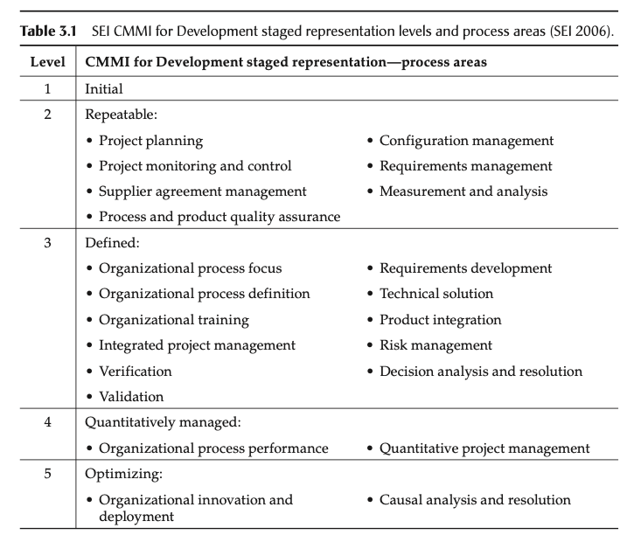
Chapter 3 C. Standards and Models
Standard: Specify a requirement
Size, Content, Value, Quality
Vs. Guidelines, Regulations, Model
ISO 9001 Standards
IEEE Software Engineering Standards
SEI Capability Maturity Model Integration (CMMi)

Slide 19
IEEE Software Engineering Standards
• 730-2002 Standard for Software Quality Assurance Plans
• 828-2005 Standard for Software Configuration Management Plans
• 829-2008 Standard for Software and System Test Documentation
• 830-1998 Recommended Practice for Software Requirements Specifications
• 982.1-2005 Standard Dictionary of Measures of the Software Aspect of Dependability
1008-1987 (reaffirmed 2002) Standard for Software Unit Testing
1012-2004 Standard for Software Verification and Validation
1016-1998 Recommended Practice for Software Design Descriptions
1028-2008 Standard for Software Reviews and Audits
1044-1993 (reaffirmed 2002) Standard Classification for Software Anomalies
1058-1998 Standard for Software Project Management Plans
1061-1998 (reaffirmed 2004) Standard for a Software Quality Metrics Methodology
• 1062a-1998 (reaffirmed 2002) Recommended Practice for Software Acquisition
• 1063-2001 (reaffirmed 2007) Standard for Software User Documentation
• 1074-2006 Standard for Developing Software Project Life Cycle Process
• 1175.1-2002 Guide for CASE Tool Interconnections—Classification and Description
• 1175.2-2006 Recommended Practice for CASE Tool Interconnections— Classification and Description
• 1175.3-2004 Standard for CASE Tool Interconnections—Reference Model for Specifying Software Behavior
1220-2005 Standard for the Application and Management of the Systems Engineering Process
1228-1994 (reaffirmed 2002) Standard for Software Safety Plans
1233-1996 (reaffirmed 2002) Guide for Developing System Requirements Specifications
1320.1-1998 (reaffirmed 2004) Standard for Functional Modeling Language Syntax and Semantics for IDEF0
1320.2-1998 (reaffirmed 2004) Standard for Conceptual Modeling Language Syntax and Semantics for IDEF1X97 (IDEFobject)
1362-1998 (reaffirmed 2007) Guide for Information Technology—System Definition—Concept of Operations (ConOps) Document
1362a-1998 (reaffirmed 2007) Guide for Information Technology—System Definition—Concept of Operations Document: Content Map for IEEE 12207:1
1462-1998 (reaffirmed 2004) Adoption of International Standard ISO/IEC 14102: 1995—Information Technology—Guideline for the Evaluation and Selection of CASE Tools
1465-1998 (reaffirmed 2004) Standard—Adoption of International Standard ISO/IEC 12119: 1994(E)—Information Technology—Software Packages Quality Requirements and Testing
1471-2000 Recommended Practice for Architectural Description of Software Intensive Systems
1490-2003 Guide Adoption of PMI Standard—A Guide to the Project Management Body of Knowledge
1517-1999 (reaffirmed 2004) Standard for Information Technology—Software Life Cycle Processes—Reuse Processes
2001-2002 Recommended Practice for Internet Practices—Web Site Engineering, Web Site Management and Web Site Life Cycle
12207-2008 Systems and Software Engineering—Software Life Cycle Processes
12207.1-1997 Guide for Information Technology—Software Life Cycle Processes—Life Cycle Data
12207.2-1997 Guide for Information Technology—Software Life Cycle Processes—Implementation Considerations
14143.1-2000 (reaffirmed 2005) ISO/IEC 14143-1:1998 Information Technology—Software Measurement—Functional Size Measurement—Part 1: Definition of Concepts
14764-2006 ISO/IEC 14764:2006 Standard for Software Engineering—Software Life Cycle Processes—Maintenance
15288-2008 Systems and Software Engineering—System Life Cycle Processes
16085-2006 ISO/IEC 16085:2006 Standard for Software Engineering—Software Life Cycle Processes—Risk Management

Slide 20
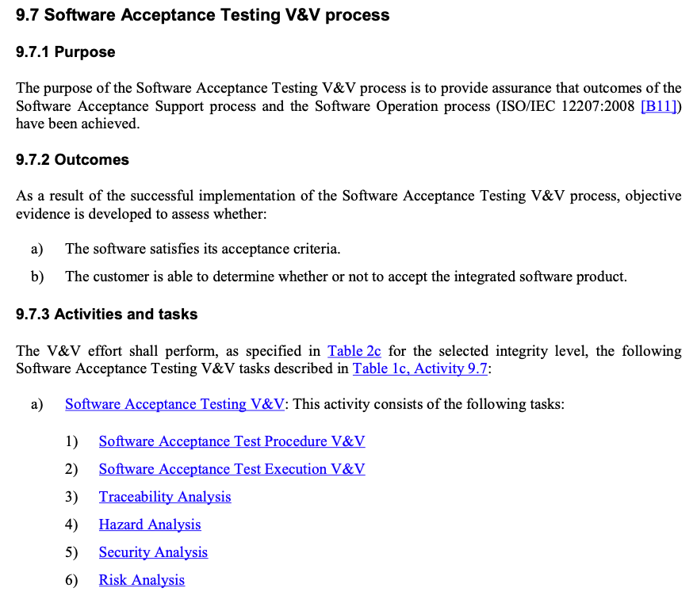
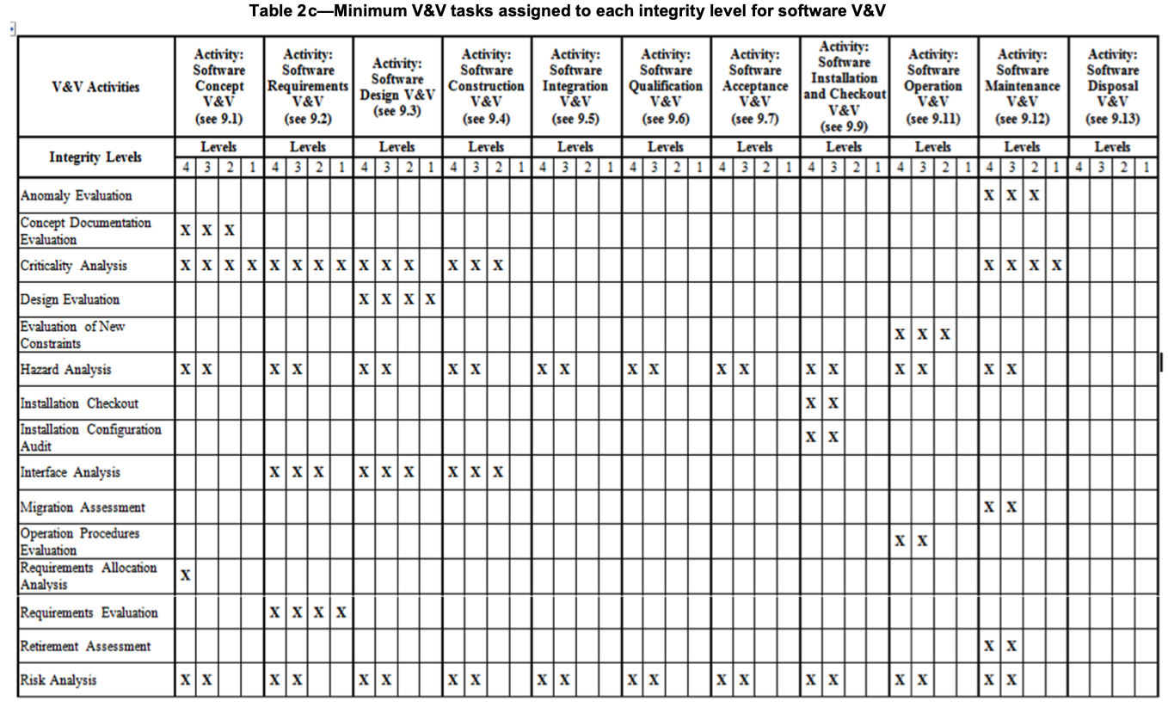
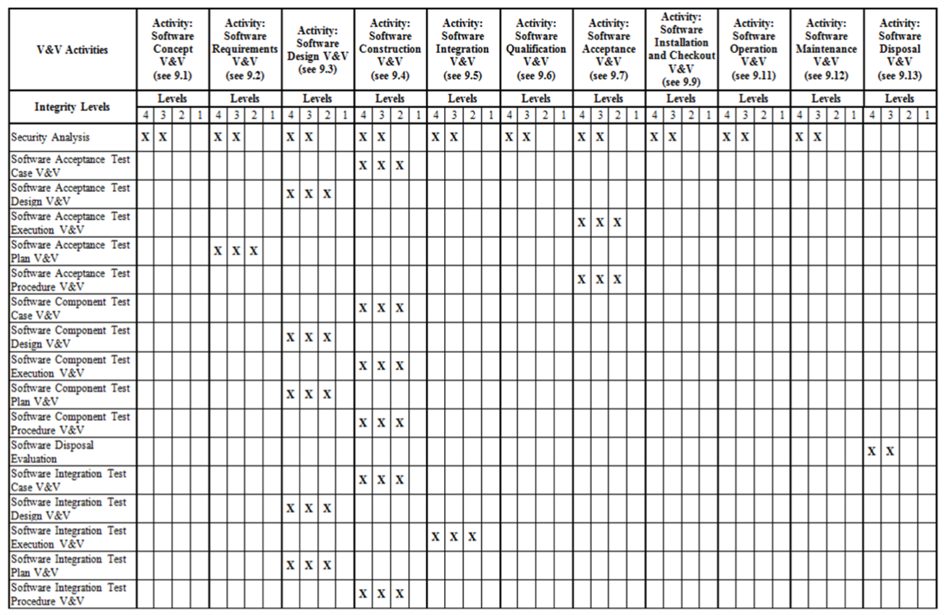
IEEE Standard for System, Software, and Hardware Verification and Validation," in IEEE Std 1012-2016
Section 9: Software V&V processes – only elements dealing with Hazard, security, and risk analysis
Hazard Analysis
Security Analysis
Risk Analysis

Slide 21
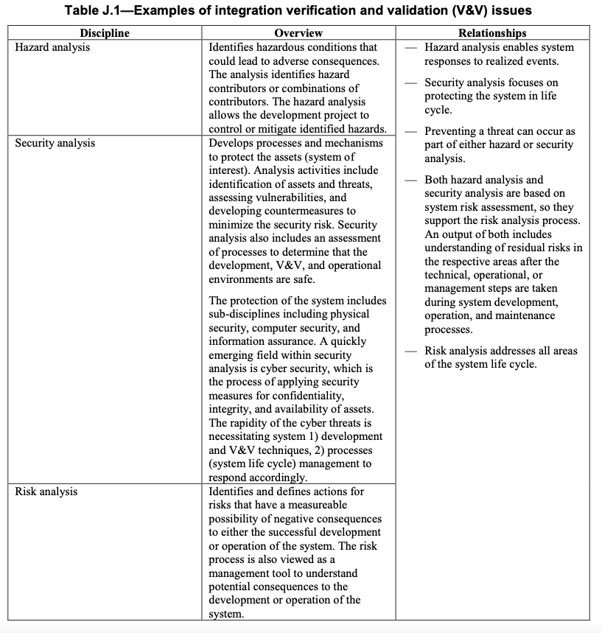
Annex J: (informative) Hazard, security, and risk analysis
J.1 Introduction
J.2 Hazard analysis
J.3 Security analysis
J.4 Risk analysis

Slide 22
Annex J: (informative) Hazard, security, and risk analysis
J.2 Hazard analysis
Traceability of requirements -> SWLC
Contributors
Architectures and Design
Verification methods (analysis, inspection, demonstration, or test)
Statistical analysis
Inspections that stnds/reg are followed
Operational Demonstrations
Tests Hazard Fault Parameters (physical, procedural, and automated controls)

Slide 23
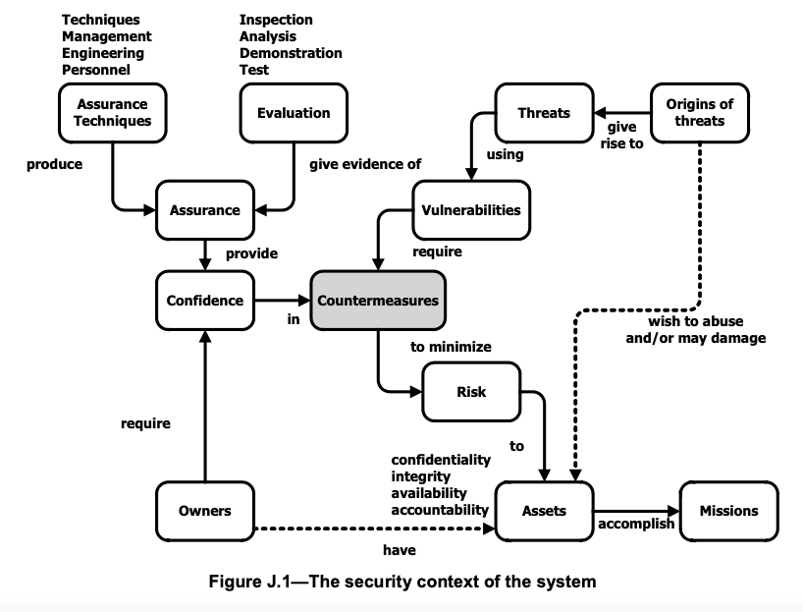
Annex J: (informative) Hazard, security, and risk analysis
J.3 Security analysis
J.3.1 Summary
J.3.2 Threat-based security analysis
J.3.2.1 Overview
J.3.2.2 Typical threats
Types
Forms: Commuincation, Database injection, signals replay, spoofing, social engr, phishing, malicious code, escalation of privileges, destruction
Sources: Insider, Outsider, Nature
J.3.2.3 Typical vulnerabilities
J.3.3 Process assurance consideration in system life cycle

Slide 24
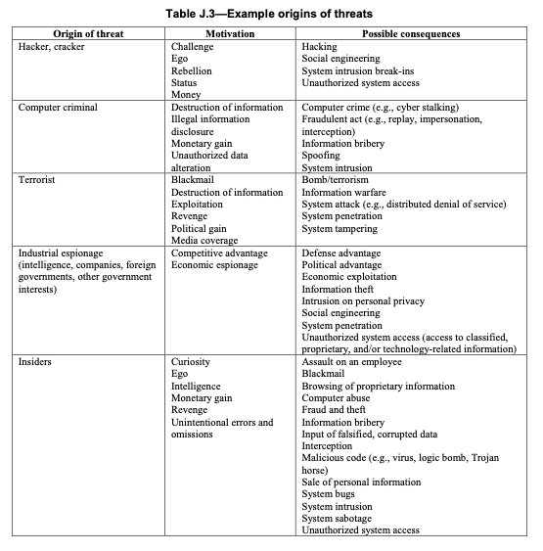

Slide 25
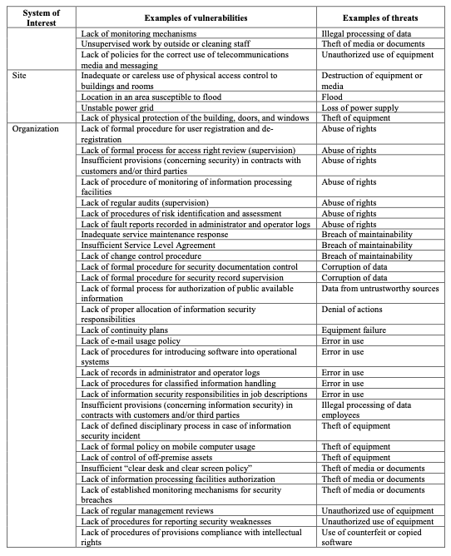
Annex J: (informative) Hazard, security, and risk analysis

Slide 27
Annex J: (informative) Hazard, security, and risk analysis
J.4 Risk analysis
J.4.1 Risk analysis objectives
Identifying the initiating events, hazards, threats, or situations that create risks.
Estimating the probability of occurrence, the consequences for each risk, and the expected timing of the risk.
Evaluating each risk or defined combination of risks against its applicable threshold, generate alternatives to treat risks above their risk thresholds, and make recommendations for treatment based on a priority order.
J.4.2 Risk analysis context
J.4.3 V&V risk analysis
J.4.3.1 Risk identification
Types of Risk
J.4.3.2 Risk estimation
J.4.3.3 Risk evaluation
Types of Risks
a) Risk that the system, as specified, will not meet stakeholder needs and requirements.
b) Risk that the system may exhibit undesired behavior.
c) Risk that engineering and integration plans will not enable accomplishment of V&V objectives through system integration/buildup.
d) Risk that the acceptability of system or system elements cannot be determined.
e) Risk that artifact quality or defect trends will impair accomplishment of project milestones or system operational objectives.
f) Risk that the likelihood of reaching a defined hazardous condition is too high.
g) Risk that security threats protections are not adequate.
h) Risk that security vulnerabilities are not adequately ameliorated.
i) Risk that the system is not maintainable.

Slide 29
Ethics
Values
Practice
Principles
Research

Slide 30
Evidence of Quality
Legal
Regulations
Due Care
Policies
Due Process
Evidence
Law
Ethics
Practices
Procedures
Reviews
Audits
Process
Standards
Baselines
Guidelines
Implementation

Slide 31
Powers That Be… Friend or Foe
You & Your Job
Nature
Government
Politics
Academia
Corporations
Military
Religion
Medical

Slide 32
Powers That Be… Friend or Foe
You & Your Job
Nature
Government
Politics
Academia
Corporations
Military
Religion
Medical
People/
Culture
?

Slide 33
Chapter 2 B. Ethical and Legal Compliance
1. ASQ Code of Ethics
Conflicts of Interest
2. Legal and Regulatory Issues
Contracts
Intellectual Property Rights
Data Privacy
Sarbanes-Oxley Act
Tort
Black’s Law Dictionary (Futrell 2002) defines a tort as “a wrongful act other than a breach of contract that injures another and for which the law imposes civil liabilities.”
Conversion - steal from the customer or destroy property
Negligence - failure to complete step that could cause damage
Strict product liability - dangerous defects
Malpractice - poor professional services
Fraud - misrepresented capabilities

Slide 34



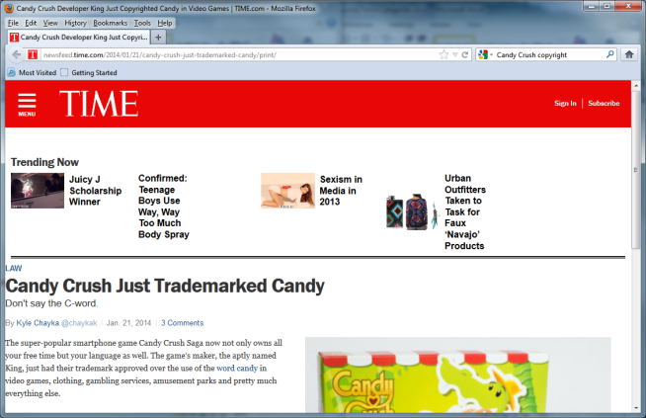

What is “intellectual property?”
Common types of intellectual property rights include
copyright,
trademarks,
patents,
industrial design rights,
trade dress, and
in some jurisdictions trade secrets.

Slide 35
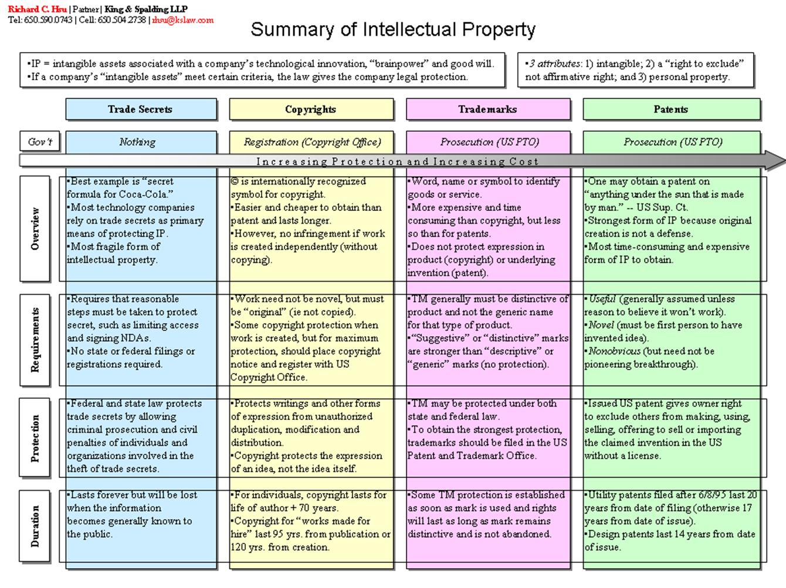

Slide 36
Patents
Patents are issued by the U.S. Patent and Trademark office after a detailed and often costly application submission and review process that can often take years to complete. A patent is good for up to 20 years, provided that you pay the required maintenance fees to the U.S. Patent and Trademark Office.

Slide 37
This from the U.S. Copyright Office
“Copyright does not protect the idea for a game, its name or title, or the method or methods for playing it. Nor does copyright protect any idea, system, method, device, or trademark material involved in developing, merchandising, or playing a game.
Once a game has been made public, nothing in the copyright law prevents others from developing another game based on similar principles. Copyright protects only the particular manner of an author’s expression in literary, artistic, or musical form.”

Slide 38
Chapter 2 B. Ethical and Legal Compliance
1. ASQ Code of Ethics
Conflicts of Interest
2. Legal and Regulatory Issues
Contracts
Intellectual Property Rights
Data Privacy
Sarbanes-Oxley Act
Tort
Black’s Law Dictionary (Futrell 2002) defines a tort as “a wrongful act other than a breach of contract that injures another and for which the law imposes civil liabilities.”
Conversion - steal from the customer or destroy property
Negligence - failure to complete step that could cause damage
Strict product liability - dangerous defects
Malpractice - poor professional services
Fraud - misrepresented capabilities

Slide 39
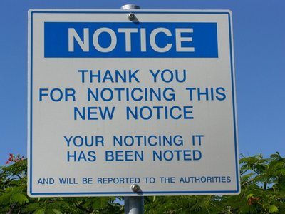



Security Documentation
Acceptable use policy (AUP)
Define Actions & Communication of Monitoring
Notify of Monitoring
Monitor ALL employees
Comply with Legal Requirements
Change and configuration management policy
hardware, software, and infrastructure configurations
Tracks and documents significant changes
Assesses the risk
Proper testing and approval processes
Privacy policy
Personally Identifiable Information (PII)
Full Name
Address
Telephone number
Driver's license
National Identification Number
Credit card numbers
E-mail address
Notes:
http://www.blogging4jobs.com/wp-content/uploads/2012/04/employee-breakroom-sign.jpg

Slide 40



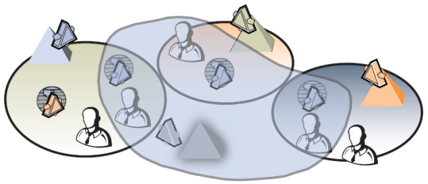
Security Documentation
User education and awareness training
Familiarize employees with the security policy.
Communicate standards, procedures, and baselines that apply to the employee's job.
Facilitate employee ownership and recognition of security responsibilities.
Establish reporting procedures for suspected security violations
A resource allocation
Staffing
Technology
Budgets
User management policies
Network access
Equipment configuration
Software configuration
Notes:
http://www.projectinsight.net/i/project-management-software/planning/resource-allocation.jpg
http://www.google.com/intl/en/chrome/assets/common/images/content/boxofapps.png
http://i.msdn.microsoft.com/dynimg/IC205546.jpg

Slide 41

Security Documentation
Service Level Agreements (SLAs)
Guarantees :
Turn-around times
Average response times
Number of on-line users
System utilization rates
System up-times
Volume of transactions
Production problems
Code escrow agreement
. For example, a code escrow agreement could specify that you can obtain the source code from a vendor if the vendor went out of business
Notes:
https://www.colocationamerica.com/picts/blog/service-level-agreement.JPG

Slide 42

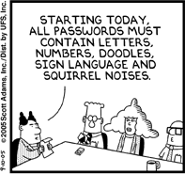
Security Documentation
Password policies
The same password should never be used for different systems.
Accounts should be disabled or locked out after a specified amount of failed login attempts.
Passwords should never contain words, slang, or acronyms.
Users should be required to change their passwords within a certain time frame and to use a rotation policy.
A strong password policy should be enforced. Strong passwords:
Contain multiple character types, uppercase, lowercase, numbers, and symbols.
Are a minimum length of eight characters or more.
Use no part of a username or e-mail address.
Notes:
http://upload.wikimedia.org/wikipedia/en/f/f3/Dilbert-20050910.png?w=300&h=300

Slide 43

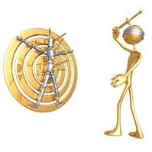
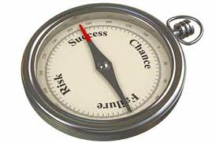
Policy Best Practices
Formally define a policy creation and policy maintenance
Policies should survive for two or three years
Do not be too specific in policy statements
Use forceful, directive wording
Technical implementation details do not belong in a policy
Keep each policy as short as possible
Provide references in policy to the supporting documents
Thoroughly review before publishing
Conduct management review and sign-off
Employees should acknowledge policies
Do not use technical jargon in policy language
Review incidents and adjust policies
Periodically review policies
Define policy exception rules
Develop sanctions for noncompliance

Slide 44

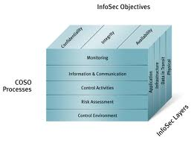
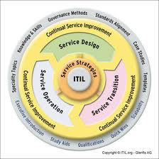
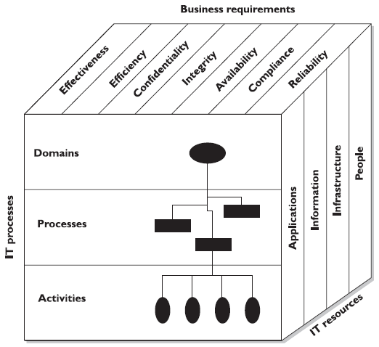
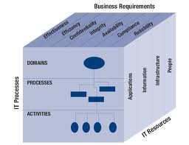
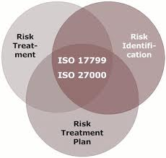
Security Audit Frameworks
COSO – Committee of Sponsoring Organizations of the Teadway Commision
Fraudulent financial reporting
ITIL – IT Infrastructure Library
IT core operational processes – change & release
COBIT – Control Objectives for Information and related Technology
34 high-level processs
ISO 27000 (ISO 17799/BS7799)
11 areas of controls

Slide 45
Comparison of Assessment Processes
 | PCI-DSS | ISO 27000 | HIPAA | DIACAP | FISMA
Source | Vendor | Private/Fee Based | Public | Public | Public
Applicability | Credit Card | Business & Government | Healthcare | DoD | ALL
Control Families | 6 | 15 | 3 | 8 | 18
Last Updated | 2010 V 2.0 | 2005 V2 | 2003 V1 | 2008 V1 | 2009 V 3
Complexity | 5 | 8 | 3 | Scales Low-High | Scales Low-High
Sophistication | 4 | 6 | 2 | 8 | 10

Slide 46
FISMA Security Requirements
CLASS | FAMILY
Management | RA | Risk Assessment
Management | PL | Planning
Management | SA | System and Services Acquisition
Management | CA | Certification, Accreditation, and Security Assessments
Management | PM | Project Management
Operational | PS | Personnel Security
Operational | PE | Physical and Environmental Protection
Operational | CP | Contingency Planning
Operational | CM | Configuration Management
Operational | MA | Maintenance
Operational | SI | System and Information Integrity
Operational | MP | Media Protection
Operational | IR | Incident Response
Operational | AT | Awareness and Training
Technical | IA | Identification and Authentication
Technical | AC | Access Control
Technical | AU | Audit and Accountability
Technical | SC | System and Communications Protection

Slide 47


Personnel Security
Hiring Practices
Job Descriptions
Employment Agreements
Reference Checks
Background Investigations (Credit, Criminal, Drug Testing, Education, Prior Employment, SSN, Watch List)
Employee Controls
Employee Supervision
Termination

Slide 48



Best Practices
Principle of least privilege - Implicit deny
Least privilege - Only allow access to the resources and processes required to complete tasks
Separation of duties
Segregated processes or tasks
Job rotation
technique where users are cross-trained in multiple job positions
Defense-in-depth
using multi methods
Mandatory Vacations
Benefits of job rotation
Job Position Sensitivity
Department assessment of access

Slide 49

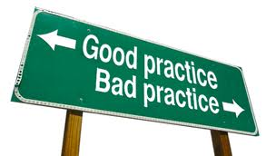
Best Practices (cont)
Security Awareness Programs
Budget for Information Security Activities
Understand Business Objectives
Maintain Awareness of Emerging Threats and Vulnerabilities
Evaluate Security Incidents and Response
Develop Security Compliance Program
Establish Security Matrix
Participate in Management Meeting
Ensure Compliance with Government and Industry Regulations
Assist Internal and External Audits
Stay Abreast of Emerging Technologies

Slide 50

Reporting
Maintain visibility & limit distortion or inaccurate translation of messages
Reporting to
The CEO
IT
Corp Security
Admin Services Dept
Issuance and Risk Management
Internal Audit Department
Legal Department

Slide 51


Information Classifications
Public with full distribution allows everyone to have free access to a copy of the information with no restrictions
Public with limited distribution allows private information to be distributed to only selected individuals for a specific purpose
Private internal information is restricted to individuals within the organization
Private restricted information is restricted to limited authorized personnel within the organization
Notes:
http://jurinnovzone.jurinnovltd.netdna-cdn.com/wp-content/uploads/2012/06/Data_Classification_Benefits_Information_Security.jpg

Slide 52
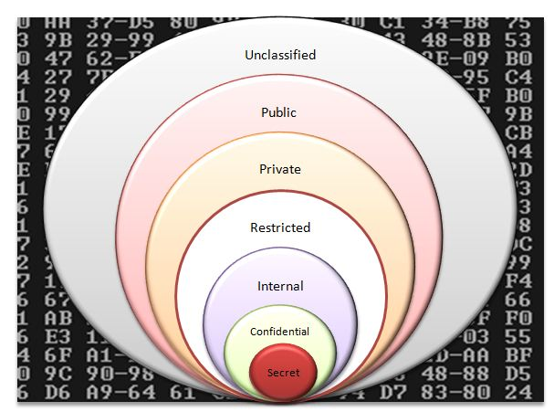
Government and Military Classifications
Unclassified information is information that can be accessed by the public and poses no security threat.
Sensitive but unclassified information is information that, if disclosed, could cause minimal harm, but not a national disaster
Confidential information is the lowest level of classified information used by the military.
Secret information is information that, if disclosed, could cause severe and permanent damage to military actions
Top secret information is the highest level of classified information used by the military
Notes:
http://www.maintec.com/blog/wp-content/uploads/2011/08/Data-Classification-pic2.jpg

Slide 53
Private Sector Classifications
Confidential
Trade Secret
Private
Non-disclosure Agreement (NDA)
Management Restricted
Sensitive
Board Restricted
For Official use only
Proprietry
Privileged

Slide 54
Awareness and Training

Slide 55
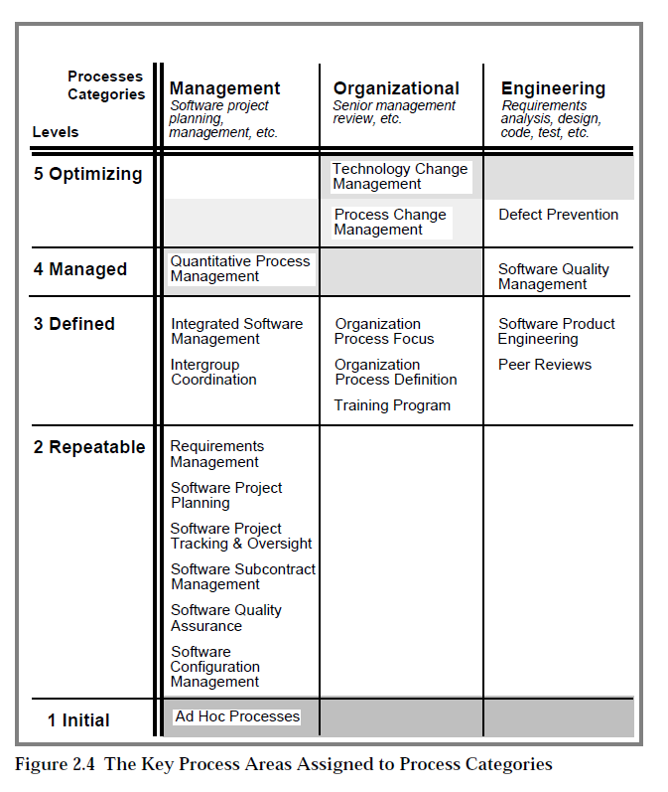
The key process areas at Level 3
Organization Process Focus p 188
Organization Process Definition p 198
Training Program p 212
Integrated Software Management p 223
Software Product Engineering p 246
Intergroup Coordination p 272
Peer Reviews p 284
Level 2->3: Process are used at Organizational Level

Slide 56
Training Program
Activity 1 Each software project develops and maintains a training plan that specifies its training needs.
Activity 2 The organization's training plan is developed and revised according to a documented procedure.
Activity 3 The training for the organization is performed in accordance with the organization's training plan.
Activity 4 Training courses prepared at the organization leve are developed and maintained according to organization standards.
Activity 5 A waiver procedure for required training is established and used to determine whether individuals already possess the knowledge and skills required to perform in their designated roles.
Activity 6 Records of training are maintained.

Slide 57
IEEE Std 1012-2016 IEEE Standard for System, Software, and Hardware Verification, and Validation
Software Qualification Test Plan V&V
The V&V software qualification test plan shall address the following:
Adequacy of user documentation (e.g., training materials and procedural changes).
Optional verification and validation (V&V) tasks
Training documentation evaluation. Evaluate the training materials and procedures for completeness, correctness, readability, and effectiveness.
User training. Assure that the user training includes rules that are specific to the administrative, operational, and application aspects, as well as the industry standards for that system. This training should be based on the technical user documentation and procedures provided by the manufacturer of the system. The organization responsible for the use of the system should be responsible for providing appropriate user training.

Slide 58

Training
Security Training
Training Topics: Policies, Programs, Compliance, Social Engineering, Business Continuity & Disaster Recovery, Data Classification, etc
Specialized Security Training
Job Training
Professional Training/Education

Slide 59
IEEE Std 829-2008: IEEE Standard for Software and System Test Documentation
9.3.6 (LTP Section 3.6) Training
Specify test training needs by skill level. Identify training options for providing necessary skills.
Training can be varied, including options such as traditional classroom training, self-paced computer-based training, training over the Internet, visiting the future user site, and mentoring by more knowledgeable staff members.

Slide 60
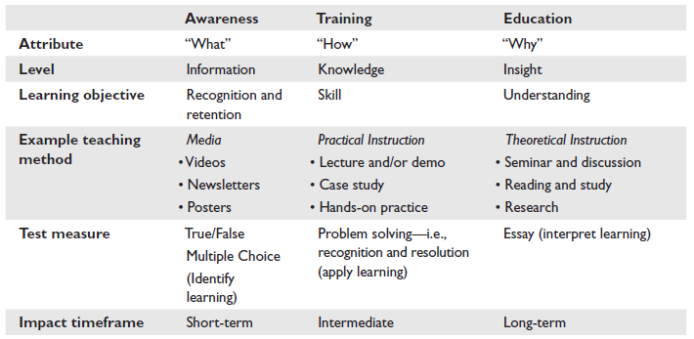

Aspects of Awareness, Training and Education

Slide 61
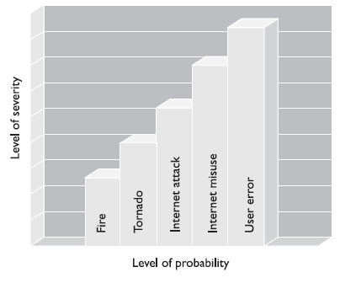
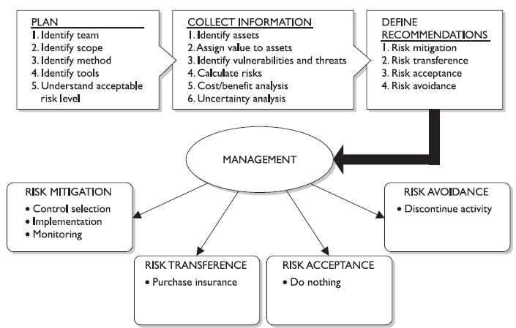
Risk Assessment
Process
Identify Vulnerabilities
Identify Threats
Likelihood Determination
Determination of Impact
Determine of Risk
Reporting Findings
Countermeasure Selection
Information Valuation
Plans
Business Continuity Plan
Disaster Recovery Plan
Continuity Of Operations Plan (COOP)
Threat
Vulnerabilities
Asset
Risk
Attack
Attack: A ‘threat’ exploiting a ‘vulnerability’ to effect an ‘asset’

